Slide 1
Spotting Physical, Motor and Sensory Difficulties and How They Look In The Classroom:
This section will help staff by:
Sharing some pointers for how to spot children who might be developing differently to their peers
Providing more detail about the disorders and difficulties that relate to the senses and movement
What these disorders and difficulties may look like in the classroom when they prevent learners reaching physical and motor milestones

Slide 2
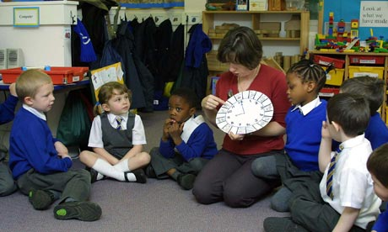
Spotting Difficulties when Children Don’t Meet the Developmental Milestones
Children start school from a very young age and enter with varying ability levels, experiences and needs generally, as well as from a physical and sensory perspective.
Without very obvious difficulties from very early an early age, it tends to be that children’s additional needs are not identified until they reach and engage in the education system.
It is then that differences are noted in academic achievement when skills are compared to peers’ abilities. This includes difficulties in physical and sensory abilities.

Slide 3
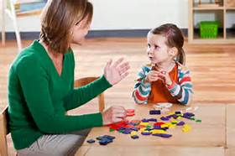
Spotting Difficulties when Children Don’t Meet the Developmental Milestones
Increasingly children are being identified as having additional needs, both academically and functionally while attending mainstream education.
Their needs can be assessed, and sometimes a diagnosis made in order to provide additional support for a percentage of pupils.
Identifying this enables us to provide additional support in the first instance and if this is not sufficient, to refer on to other services.

Slide 4
Spotting Difficulties when Children Don’t Meet the Developmental Milestones
The role of educational professionals is to ‘spot the differences’ and commence the process of providing additional support.
This is particularly the case when access to specialists such as Occupational Therapists, Speech and Language Therapists, Educational Psychologists and Paediatricians is restricted as is increasingly the case.
How are these differences ‘spotted’?
Some children present with subtle difficulties and can ‘fall through the net’ and as they progress in the educational system their difficulties can become more apparent. Quite frequently what are seen as ‘behaviours’ are due to their ongoing difficulties but also having the same expectation made of them as their peers with out interventions to support their needs if their issues have not been assessed and identified.

Slide 5
How Can I Help Spot the Differences?
General Tips
Keep your radar on!!!
Each individual child comes to school and is expected to engage in the same activities as their peers.
To identify those individuals that are struggling, an overall holistic view of the child is required, including:
Knowing their motor abilities
Attention and concentration for learning
Retention of information
Academic achievement
Behavior, and
Interaction etc.
Keep an eye on all of these areas and see if you can spot any anomalies.
Look at their behavior
When a child is misbehaving, think again.
Is it just because the child wants to misbehave or is this how they:
Are responding to sensory stimulus
Communicating their frustrated due to motor issues
Trying to cover up their difficulties (clowning)
Do they have emotional difficulties?
Is there a possible underlying diagnosis that requires investigation?

Slide 6
How Can I Help Spot the Differences?
General Tips
Be the detective
Why are they having these responses?
Is there a link between the behavior and difficulties they are experiencing?
Test them out,
Monitor how they are responding,
Try to find out where the difficulties lie and try to support them with activities that will promote them to be able to develop skills and gain confidence and control.

Slide 7
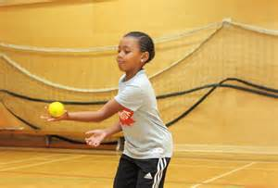
How Difficulties May Present – Primary General
The next few slides list how some difficulties may present at school. It is important to keep in mind that some difficulties may coexist meaning that a student may have a number of underlying conditions at the same time.
PE
Are they having difficulty getting dressed, and coping within the P.E. environment?
Do they have the attention and ability to carry out the activities presented? For example, can they run, jump, hop, skip or be able to attend to and take part in the game being played?
Are they having to watch others intently to try and copy movements
Are they avoiding P.E. activities?
Are they being overzealous?
Are they having difficulties engaging with peers in that environment?

Slide 8
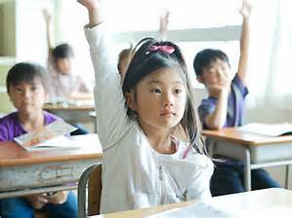
How Difficulties May Present – Primary General
Desk top tasks
Can they sit and attend (pay attention)?
Are they constantly fidgeting?
Do they have the ability to organize tools required for the activity?
Can they follow instruction?
Can they hold a pen and stabilize their work?
Can they produce shapes for writing?
Can they retain information and engage?

Slide 9
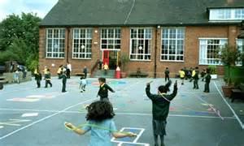
How Difficulties May Present – Primary General
Play time
Can they engage in peer games?
Are they on the periphery?
Do they have uncoordinated movements (frequent bumps and trips)?
Can they follow games routines and structures?
Do they have new ideas for games?

Slide 10
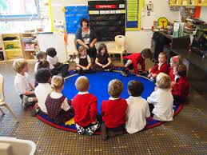
How Difficulties May Present – Primary General
Floor time
Can they sit still and focus?
Are they leaning on others or furniture?
Are they fidgeting?
Are they engaging – putting hand up to answer questions?
Can they maintain attention, retain information, and/or follow instruction?

Slide 11
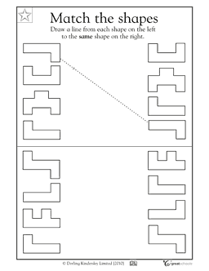
How Difficulties May Present – Primary General
Visual perceptual skills
Do they have the ability to complete puzzles?
Can they copy and draw shapes?
Can they identify shapes are the same when presented in a different way?
Can they find specific objects among other objects?
Can they recall shapes they have seen when presented with more than one?

Slide 12
How Difficulties May Present – Primary General
Handwriting
Can they produce simple pre writing shapes?
Can they draw a person?
Can they write fluidly and as well as their peers?
Is their pencil grip accurate?
Do they tire of writing quickly and easily and/or are they resistant?

Slide 13
How Difficulties May Present – Primary General
Gross and fine motor skills
Do they have any difficulty planning and carrying out new and novel fine or gross motor tasks e.g. learning to ride a bike, or use a bat and ball?
Can they quickly and effectively learn new motor skills and generalise skills for new tasks? For example, use a tennis racket then be able to use a baseball bat? These are different but require similar skills.
Are they disorganised?
Do they have poor body awareness and coordination?
Do they appear to be clumsy?
Do they have difficulty with self care skills?
Do they talk more than act?

Slide 14
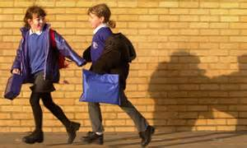
How Difficulties May Present – Primary General
Upper primary school years
During this pre-pubescent stage some learners may experience more difficulties in these areas
Some may experience other areas of difficulty due to hormonal changes, body changes, growth spurts, and emotional changes .
This can impact on engagement and function

Slide 15
How Difficulties May Present – Secondary General
General Things to Look for
Persistent lateness
Fidgeting
Inability to record work
Isolation from peers
Unkempt appearance
Food on clothes following eating
Frequent bumps and trips
Not being prepared as expected
Inability to attend during sessions
Avoidance of physical education or difficulty engaging in it
Aifficulty maintaining postures – use of furniture to prop self up

Slide 16
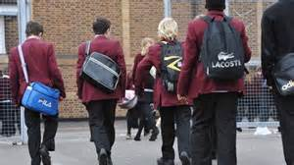
How Difficulties May Present – Secondary General
Body changes
The body goes through huge changes during puberty.
Growth spurts can be very challenging if a child already has difficulty with motor skills as they are trying to keep up with body changes as well as complete the motor tasks required of them
Sensory issues can resurface due to the body changes and this can impact behavior and responses
Be vigilant during this phase as issues may resurface and change
Moving from classroom to classroom
Negotiating moving between classes and teachers places additional challenges on learners
It can be very challenging for those with organizational difficulties
For those with sensory sensitivity moving between classes can be an exhausting challenge

Slide 17
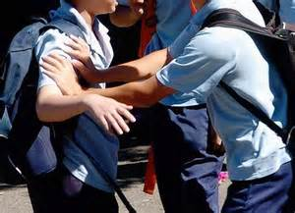
How Difficulties May Present – Secondary General
Behaviour
Social expectations change, increasing the challenges placed on a young adult
Presentation of challenging behavior can be due to many external and internal factors
The need to rule out potential physical and sensory difficulties is imperative to prevent labeling behavior when there can be a valid reason for it.
Pupils can make it through the primary education system with below average abilities, but no support, and when the challenge increases at Secondary, this becomes too much and challenging behaviours may be the result of this.

Slide 18
How Difficulties May Present – Secondary General
Autism (now becoming more apparent in girls) Girls are more likely to receive a diagnosis from year 6 upwards due to using their ability to follow social rules and communicate to mask their condition
As social, physical and academic demands increase the issues can become more apparent
The ability to express needs can become difficult with increased social isolation, and there may be persistent interest in particular subject areas.
Identification and diagnosis of autism in girls is increasing and the awareness that this can be the issue for an individual is important
Support and understanding With an understanding of the difficulties, a young adult can receive support to enable them to successfully move through the higher education system.
Others will continue to require additional support.

Slide 19
Difficulties and Disorders Which Might Include Physical and Sensory Difficulties - DCD
Developmental Coordination Disorder (DCD) is the term used in DSM-5 to refer to a condition in which an individual has severe difficulties in learning everyday motor skills, which cannot be explained by physical, sensory or intellectual impairment. The main features of this condition are clearly described in DSM-5 (the standard classification of mental disorders used by mental health professionals)
Pupils with DCD benefit greatly from appropriate occupational therapy, including physical and sensory activities

Slide 20
Difficulties and Disorders Which Might Include Physical and Sensory Difficulties – Dyspraxia
The term ‘dyspraxia’ is used in many different ways by different people, which can cause confusion. Some use it interchangeably with ‘DCD’ to mean the same thing others use it to refer to something quite different. Unlike DCD, there is no internationally agreed formal definition of the term ‘dyspraxia’, and it is not include in DSM-5 standard classification of mental disorders.
Dyspraxia includes difficulties around
Having the idea for, planning and carrying out new and novel tasks e.g. learning to ride a bike, using a bat and ball
Learning new motor skills, and inability to generalise skills for new tasks e.g. swinging a tennis racket and baseball bat are different but require similar skills
The ability to tie hair but no able to tie shoe laces, disorganised, poor body awareness and coordination
The amount of time it takes to learn new skills, clumsy appearance, difficulty with self care skills, developmental delay, more talking than action
Pupils with dyspraxia benefit greatly from appropriate occupational therapy, including physical and sensory activities.

Slide 21
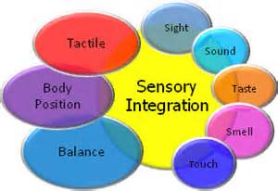
Difficulties and Disorders Which Might Include Physical and Sensory Difficulties – Autism
New DSM-V includes Sensory Issues (DSM V – 2013: “Autistic Spectrum Disorder”)
Autism is a lifelong developmental disability that affects how people perceive the world and interact with others.
Autistic people see, hear and feel the world differently to other people.
A vast body of research has identified that as many as 85% - 90% of children with Autism also present with Sensory Processing Disorders.
A research study conducted by Pfeiffer & Kinnealey (2008) found that children with autism who received sensory integration therapy had a significant decrease in displaying classic autistic mannerisms, and achieved improvement towards individual goals.
Sensory Integration
‘The neurological process that organises sensations from one’s own body and from the environment and makes it possible to use the body effectively within the environment’ (Bundy 2002 pg 4)

Slide 22
Difficulties and Disorders Which Might Include Physical and Sensory Difficulties – Physical Disabilities
Physical disabilities are wide ranging .
These affect the an individuals ability to engage in functional activity due to difficulty controlling motor movement.
Levels of severity differ greatly.
It can affect:
Poor positioning when seated - affecting – concentration
Ability to develop refined fine motor skills
Difficulty with motor control – walking, running, access to physical education
Retention of gross motor movements, difficulty developing fine movements
Increased flexion – wrist held bent, or extension difficulty bringing hands into midline
Increased tone
Difficulty with bilateral hand use (Not being able to use both hands to complete a task)
Tactile discrimination difficulties (Not being able to feel different textures or shapes)
Self care difficulties
Children with a physical disability will generally have received support and advice for positioning, function and engagement however a consistent approach is required in order for learners to be able to continually follow advice for function

Slide 23
Difficulties and Disorders Which Might Include Physical and Sensory Difficulties – Global Developmental Delay
Global developmental delay is an umbrella term used when children are significantly delayed in their cognitive and physical development.
It is usually accompanied by having significant limitations in communication.
It is said to affect about 1-3% of the population.
Children with GDD benefit from having regular occupational therapy as well as other interventions.
It can include:
The child being unable to sit on the floor without support by 8 months or crawl by 12 months;
The child having poor social skills/ judgment;
The child having communication problems
The child having fine/ gross motor difficulties

Slide 24
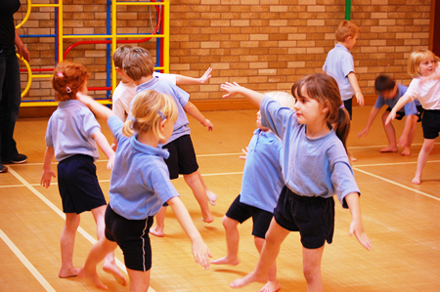
Developing Skills and Age
Children are all different and develop skills at different times.
Although there is an expected timescale for developing skills, not all children fit into this typical model
Missing stages in the building blocks can result in slower development of skills and attention required for learning
As children start school at different ages, there is a big difference in physical and sensory development and general learning, often for pupils whose birthdays are in September compared to the children who have birthdays in July or August.
This does not mean they will not achieve the skills they need to but they will be functioning at differing ability levels
Younger children in a class may particularly benefit from regular movement activities as part of their learning.

